Slide 1
Legacy filesystems
Förlegade filsystem
Notes:
Networkbased filesystems, anyone looking for me thrashing ZFS will be disapointed
Tack CJ för ämnet!

Slide 2
Per-Erik Persson
Technical IT-security
Infrastructure
Development
Identity management
DevSecOps
Platform engineering?
~40 years of hacking
Notes:
Calculating 40 years from my first computer

Slide 3
index
FTP
NFS
AFS
SMB
ACL
More NFS
GlusterFS
Kubernets
Questions?
Notes:
Do not hesitate to interrupt!

Slide 4
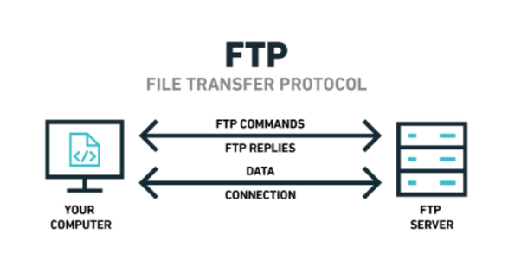
FTP(File Transfer Protocol)
Cleartext
Sftp
Ftps
disabled in Google Chrome 88 in January 2021
1980 TCP/IP support
active/passive mode
NAT/FW :-(
TFTP(netboot, today replaced with https)
Notes:
SFTP is not FTP, it is SSH:s file transfer protocol which is something completely different since SSH is used.
Plenty of security problems. Especially if the ftpserver invents their own set of filepermissions.
Data connection from server to client will not traverse NAT very well, NAT is a later invention.
FTP with jumboframes is actually fast.

Slide 5
More forgotten protocols to ignore
Apple Filing Protocol (AFP)
NetWare Core Protocol (NCP)
Bittorent
NetBIOS/NetBEUI
WebDAV
Any commercial UNIX doing NFSv4
Notes:
Old unixes had ACL:s on their filesystems when linux still was running ext2fs

Slide 6
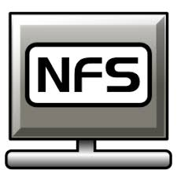
NFS(Network File System)
Version 1,2,3,4
Appears as a local filesystem. UGO, RWX 1984
V2 1989
V3 1995 TCP support, performance
webnfs(portmap, mount)
V4 2000 (AFS, SMB attributes)
V4.2 2016(pNFS, multipath, one port!)
All problem solved!
Notes:
NFS 4.1 provides multipathing for servers that support the session trunking. When the trunking is available, you can use multiple IP addresses to access a single NFS volume.
All problems not solved.

Slide 7

AFS Andrew File System
Secure
Distributed
Caching
Opensource
Big shared files
Really picky on DNS, NAT and firewalls .
ACL:s only on directories.
Applications needs to be AFS-aware.
Does not work in truly distributed environments.(laptops)
Recompile your kernel.
/afs/pdc.kth.se/home/<1st letter username>/<username>
Notes:
Inspired by NFS3, NFS4 built on the lessons of AFS
Ditched by IBM in y2k, released the source.
Developers left for netapp.
Stockholm Univerity was probably the biggest install in the world.
Cell and volumes

Slide 8

SMB Server Message Block
1982 for OS/2
1987 MS+3com
1996 SMB 1.0
Kerberos or NTLM.
SMB 3.1.1 not everywhere yet.
Have you disabled support for older versions?(bring out wireshark!)
Timing and lockingproblems in linux.(sqlite or pipelines)
SMB 2.0 has Unix extensions
Notes:
Older than NFS!
Java libraries got SMB3 support with message signing this summer.
MS reversed OS/2 and SAMBA reversed MS
Most used filesystem in the world?
Actually works if the server are not windowsbased.
MS promises that sometime in the future NTLM will be deprecated. But NTLM is nice if no AD exists.

Slide 9
ACL(which one do you mean?)
Filesystem ACL(getfacl)
POSIX.1e ACL(withdrawn drafts)
NFSv4 ACL(nfs4_getfacl)
Active Directory ACL(more complex than I understand, get-acl)
Linux has filesystem support for NFSv4_ACL but not kernel support.
Notes:
Getfacl can return plain old unix or a more complex attributes if underlying filesystem supports it.
Posix is a subset of ADACL
Samba can apply windows ACL:s but underlying fs can ignore it.
Linux world is happy with posix.
ACL:s applied on a directory does not apply backwards in time.
Explaining windows ACL:s would be a separate talk.

Slide 10
Top problems with NFS3(sloppy admins)
Norootsquash
No IPACL/FW/conf
sara:x:1000:1000:Sara Z:/home/sara:/bin/bash
Multiple groups needed
More metadata needed.
Kerberos
Working DNS
Notes:
Sloppy admins use norootsquash and export filesystems to the whole world.
Everybody with a computer can lie about uid/gid
Only one group can be solved by creating a group called sales_and_accounting but this does not reflect organisational groups.

Slide 11
More NFS problems
Nfs4 actually uses the permission model of nfs3 if kerberos is not enabled.
Kerberos requires addprinc -randkey nfs/hostnamename@REALM(on server)
ktadd nfs/clientname@REALM
Gssproxy (gssproxy.conf)
sec=krb5/krb5i/krb5p
Nfs4_acl applies on nfs3 exports, sometimes..
Notes:
Join AD and get a free host keytab! SSSD solves a lot of problems for you nowdays.
Gssproxy keeps messy stuff out of the kernel and can give certain applications the views and permissions expected.
Nfs4_acl:s can persist, but samba permissions might not.

Slide 12
NFS4 is now working, now lets enable SMB
SMB supports POSIX ACL, which is almost NFS4 ACL, but how about your underlying filesystem?
Buy a netapp, money solves problems.
Enable NFS on windows server :-)
Export filesystem as NFS3 :-)
Acces the same file mounted over both NFS3 and NFS4
Copy and move the file and look what happens to the file.
Try and run sqlite on your nfs/smbmounted disk.
Race conditions on smbmounted disks.
Notes:
In how many ways can we break our working NFS4 setup?

Slide 13

NFS4+Kerberos
Usermounts requires a personal kerberos token.
How do you convert your ssh-key to a kerberos ticket?
Putty?
Ssh-agent
Can openssh combine different authentication mechanisms?
Notes:
Gssproxy should not impersonate you to get a kerberos ticket for you.
Allowing impersonation is a huge security problem.
Putty should die! Long live openssh on windows
Openssh ssh-agent requires cool permissions, use putty-agent instead.

Slide 14
How to use kerberos with a ssh-key!
$ echo 'AuthenticationMethods gssapi-with-mic,publickey' >> /etc/ssh/sshd_config
Smartcard via ssh-agent+Kerberos<>sshkeys->Kerberos
Or just use some other MFA solution...
Notes:
Does your kerberos ticket checkout tool require physical access to your computer?
Kerberos, nfs and smb is messy.

Slide 15

GlusterFS
Client/Server model, can export NFS/SMB
A real clustered filesystem.
Inotify is working!
A real clustered filesystem.
Linux only.
Picky with versions.
EOL 2024
Notes:
RedHat bets money on Ceph
Inotify+systemd is magic

Slide 16
Performance?
Jumboframes matters!
Encryption eats up to 50% on NFS4
Appliances claim >100GB/s
How fast can your VM write to the underlying storage system?
Many files on any networked filesystem kills performance, go for S3!
Enable ACL and SELinux to maximize the number of attributes on a file.
Server side copies are sometimes supported.
Notes:
Create a new S3 bucket every day or every hour depending on the amount of data.
SELinux requires NFS4.2

Slide 17

Kubernetes
All storage vendors wants to hang around with the new cool guy on the block.
Everyone has a csi-driver today.
Most csi-drivers are based on NFS
How do we secure NFS?
Notes:
All storage vendors will say that they are kubernetes compliant.

Slide 18
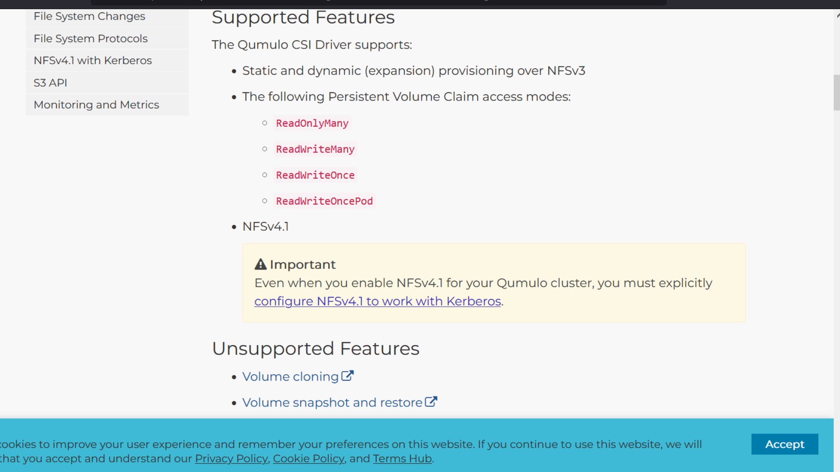
Notes:
To secure our storage for Kubernetes, we now need a working AD install.
Does NFS support cloning and snapshots?

Slide 19
Could it be any worse?
What could be worse than NFS+AD as a dependency for your kubernetes cluster??

Slide 20
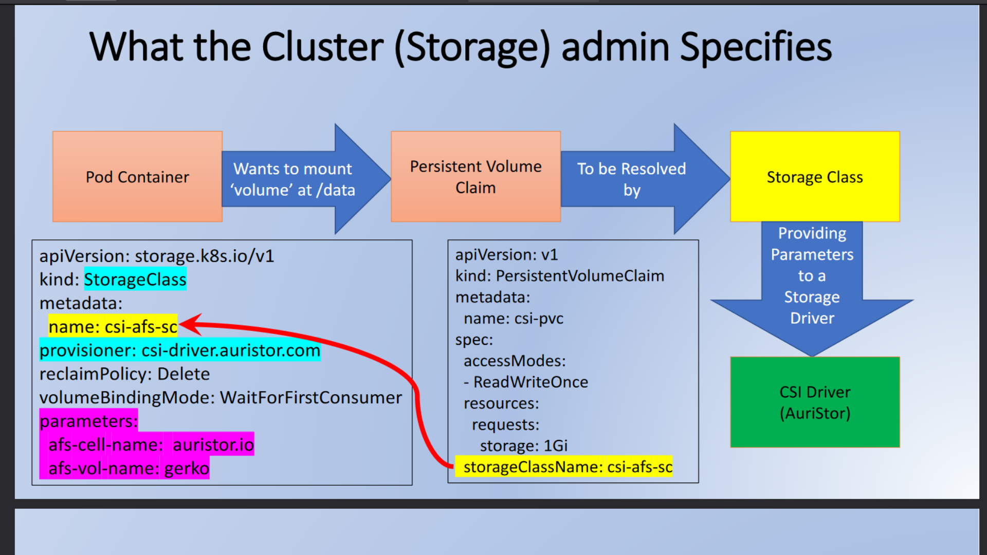

Slide 21
Summary
Don’t be afraid of SMB as long as it is not served by a windows computer.
Avoid NFS or SMB in k8s, rewrite you applications to use modern patterns.
Can your k8s cluster survive without AD and vice versa?
Can one be compromised by the other one?
How many NFS3 servers and SMB1 shares do you have around?
And Glusters?
Storagevendors seems to like NFS, why should they use ceph or longhorn?
Notes:
Do Glusterusers plan to go for ceph or anything else?

Slide 22


Questions?
peptekmail@gmail.com
Notes:
NRDE->sopra steria

Slide 23
gssproxy,conf
[service/my_app]
mechs = krb5
cred_store = keytab:/etc/path/to.keytab
euid = appuser
program = /usr/local/bin/my_app

