Slide 1


Slide 2
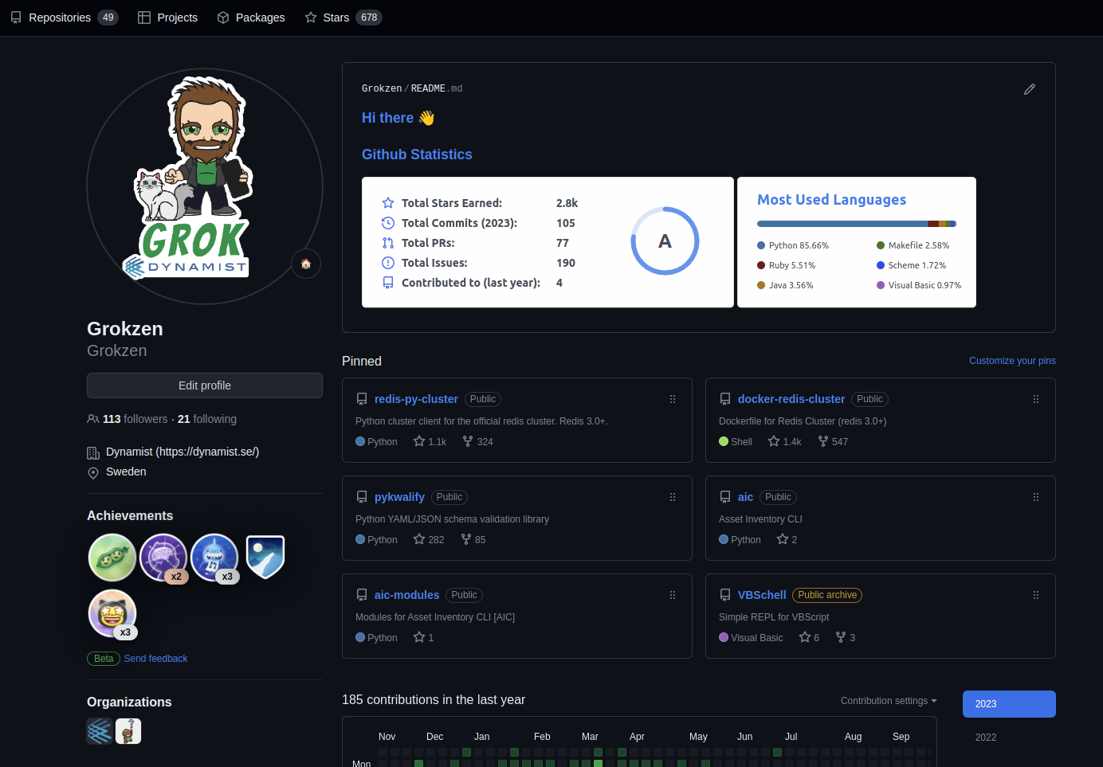

Slide 3
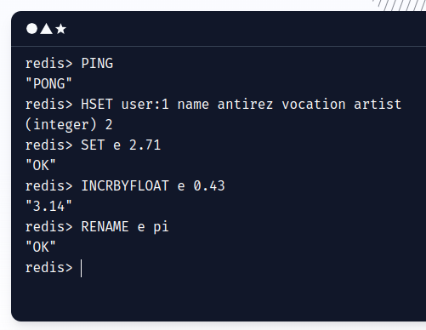

The open source, in-memory data store used by millions of developers as a database, cache, streaming engine, and message broker.

Slide 4

The Redis project began when Salvatore Sanfilippo, nicknamed antirez, the original developer of Redis, was trying to improve the scalability of his Italian startup, developing a real-time web log analyzer.
In 2009, the same year Redis was published, Chris Wanstrath, the CEO of a startup called GitHub, used Redis to build a job queue system named Resque for running GitHub’s background tasks.
In the Rails world, Resque was the most popular job queue system at the time. A successor, Sidekiq, which emerged in 2012 and was also built on Redis, is now the top choice for Rails application developers.

Slide 5
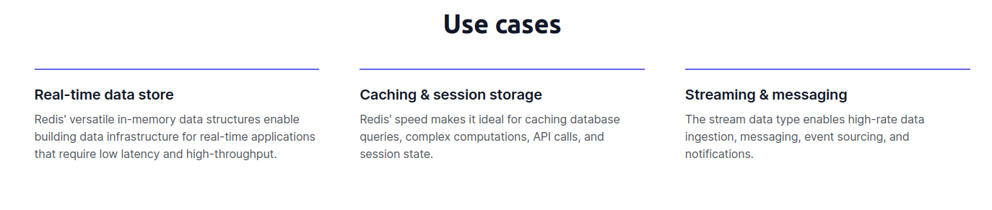
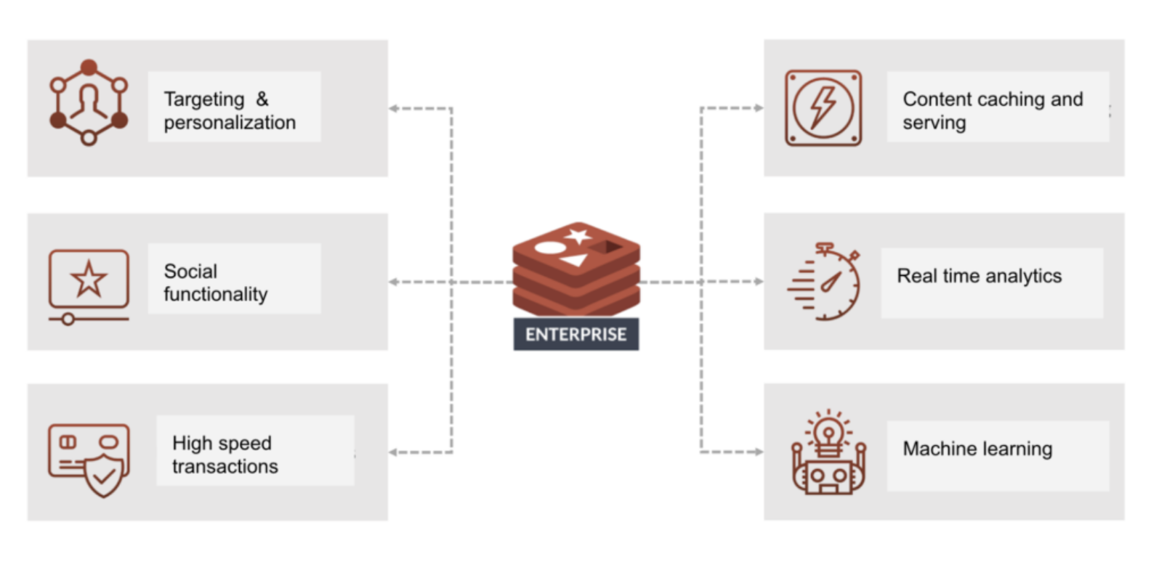

Slide 6
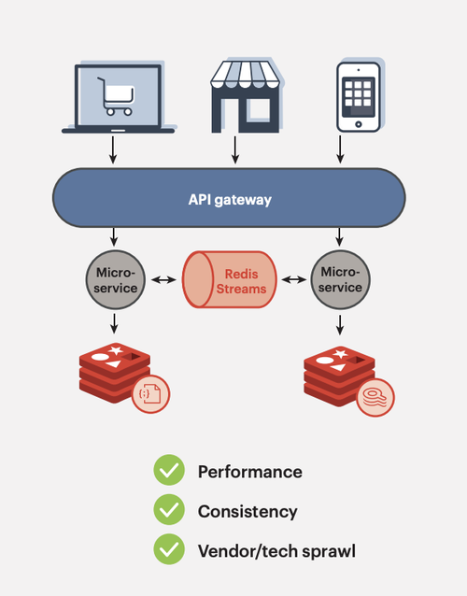
Cache
Chat, messages, queues
Session storage för webb
Geospatial indexes

Slide 7
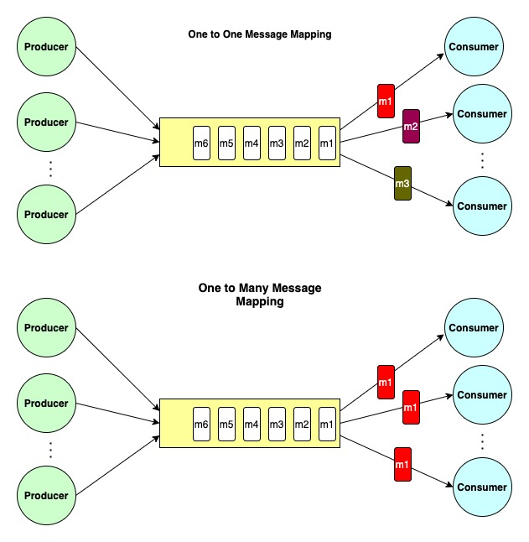

Slide 8
Performance
All Redis data resides in memory, which enables low latency and high throughput data access. Unlike traditional databases, In-memory data stores don’t require a trip to disk, reducing engine latency to microseconds. Because of this, in-memory data stores can support an order of magnitude more operations and faster response times. The result is blazing-fast performance with average read and write operations taking less than a millisecond and support for millions of operations per second.
Flexible data structures
Unlike other key-value data stores that offer limited data structures, Redis has a vast variety of data structures to meet your application needs. Redis data types include:
Simplicity and ease-of-use
Redis enables you to write traditionally complex code with fewer, simpler lines. With Redis, you write fewer lines of code to store, access, and use data in your applications. The difference is that developers who use Redis can use a simple command structure as opposed to the query languages of traditional databases. For example, you can use the Redis hash data structure to move data to a data store with only one line of code. A similar task on a data store with no hash data structures would require many lines of code to convert from one format to another. Redis comes with native data structures and many options to manipulate and interact with your data. Over a hundred open source clients are available for Redis developers. Supported languages include Java, Python, PHP, C, C++, C#, JavaScript, Node.js, Ruby, R, Go, and many others.
High availability and scalability
Redis offers a primary-replica architecture in a single node primary or a clustered topology. This allows you to build highly available solutions providing consistent performance and reliability. When you need to adjust your cluster size, various options to scale up and scale in or out are also available. This allows your cluster to grow with your demands.
Open Source
Redis is an open source project supported by a vibrant community, including AWS. There’s no vendor or technology lock in as Redis is open standards based, supports open data formats, and features a rich set of clients.

Slide 9
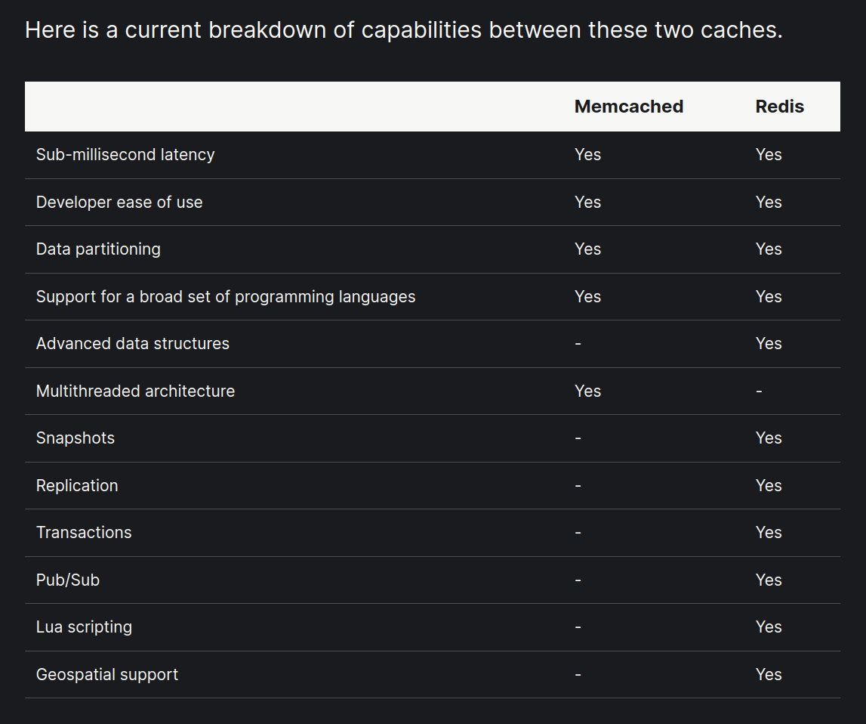

Slide 10
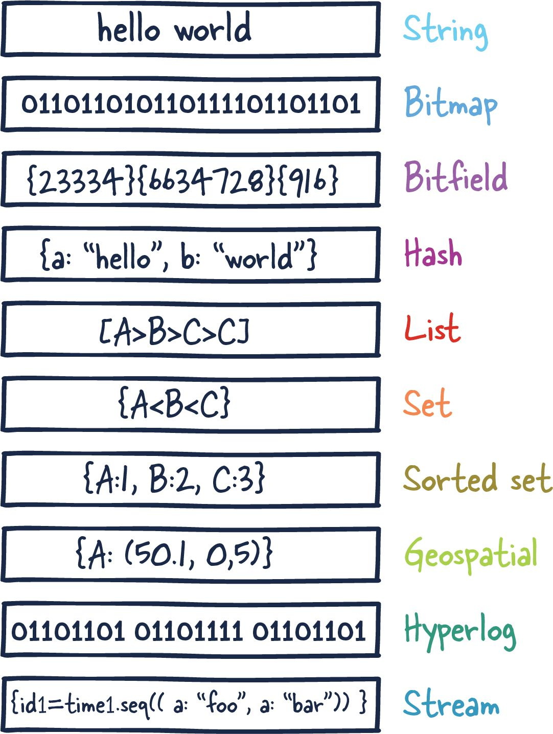
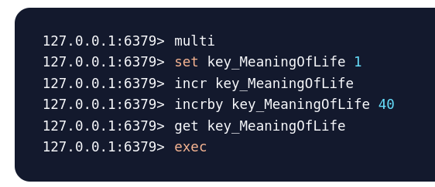

Slide 11
Redis Modules
RediSearch - A query and indexing engine for Redis, providing secondary indexing, full-text search, and aggregations.
RedisJSON - a JSON data type for Redis
RedisGraph - A graph database as a Redis module
RedisBloom - Probabilistic Datatypes Module for Redis
redis-cell - A Redis module that provides rate limiting in Redis as a single command.
RedisTimeSeries - Time series data structure for Redis
RedisAI - A Redis module for serving tensors and executing deep learning graphs
redis-roaring - Roaring Bitmaps for Redis
RedisGears - Dynamic execution framework for your Redis data

Slide 12
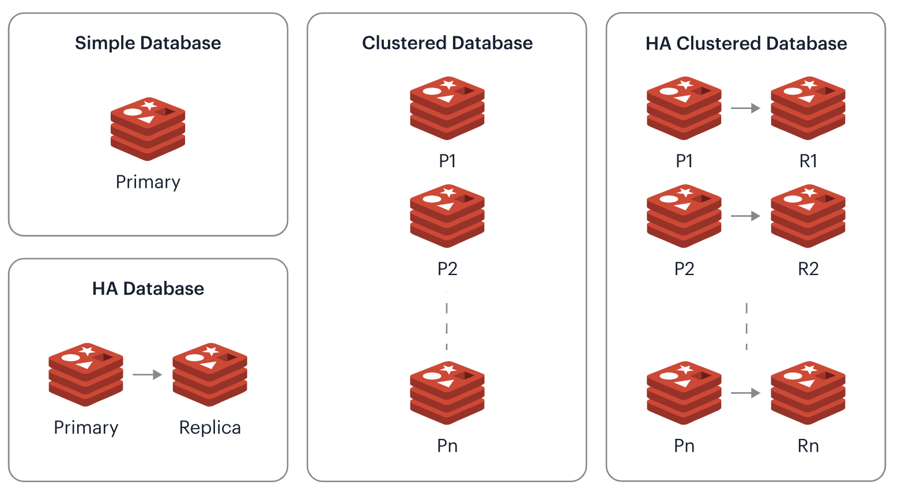

Slide 13
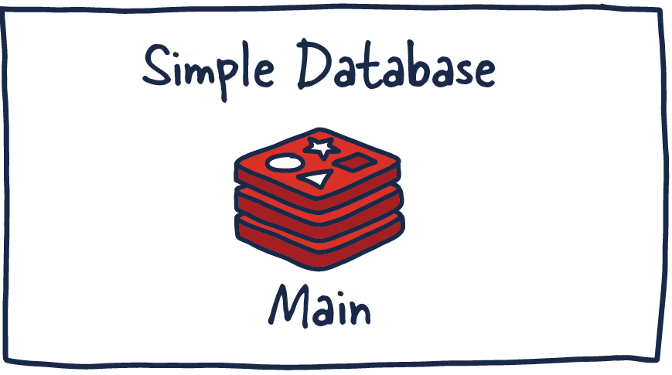

Slide 14
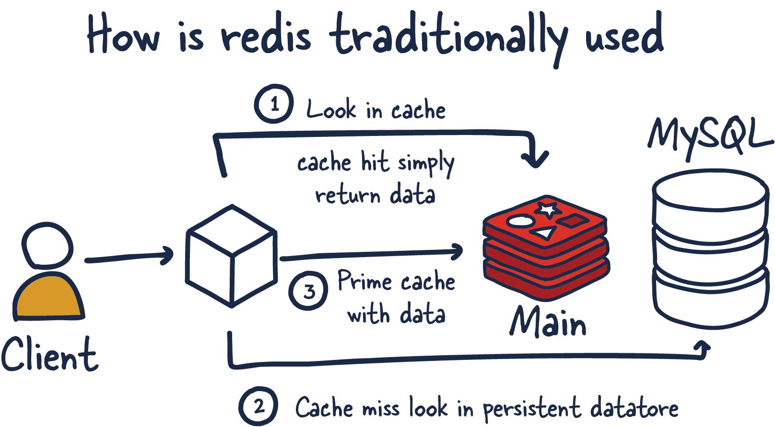

Slide 15
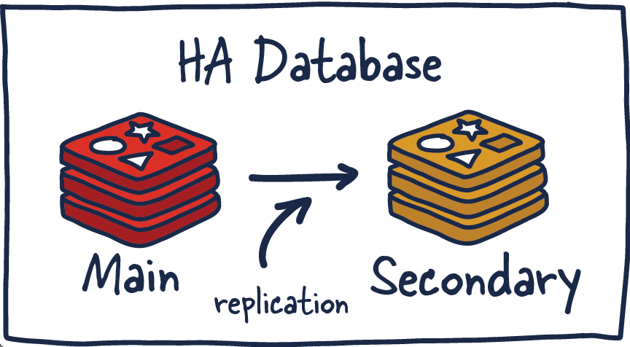

Slide 16
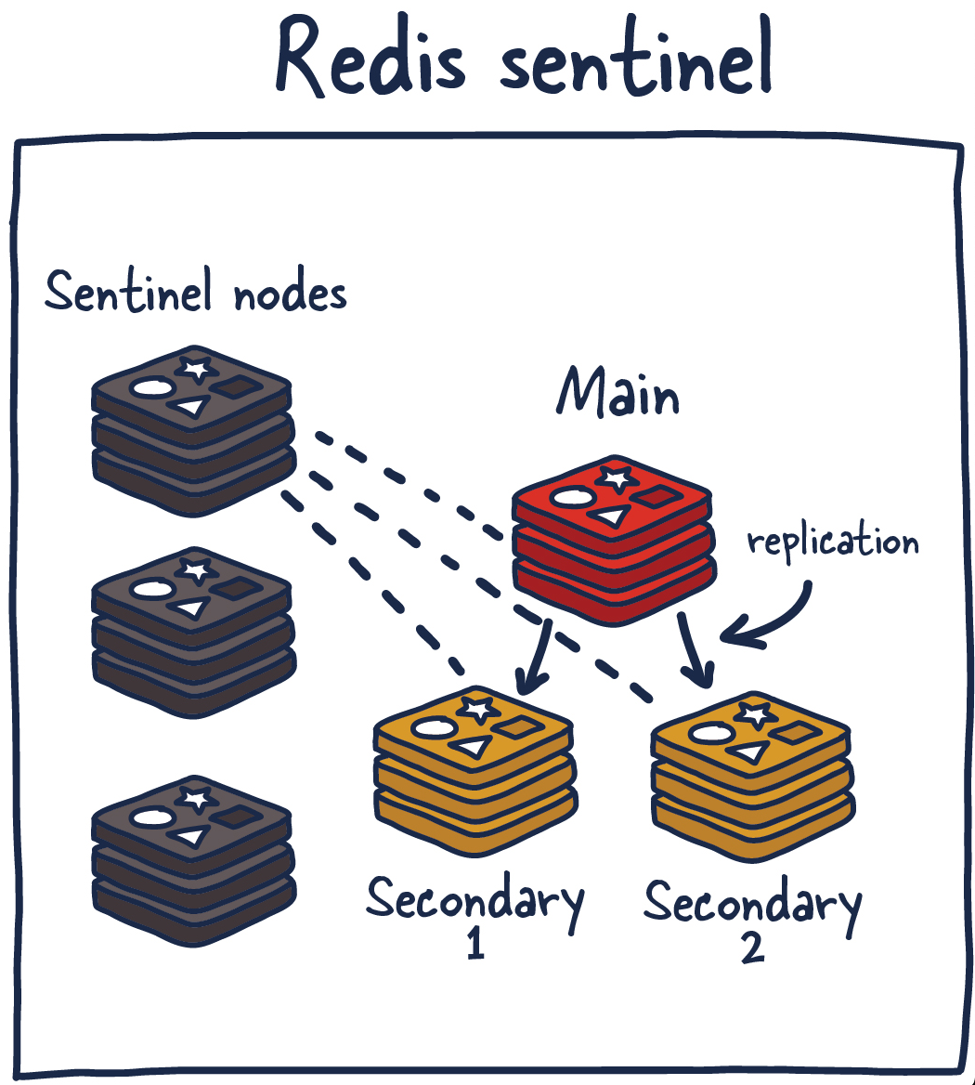

Slide 17
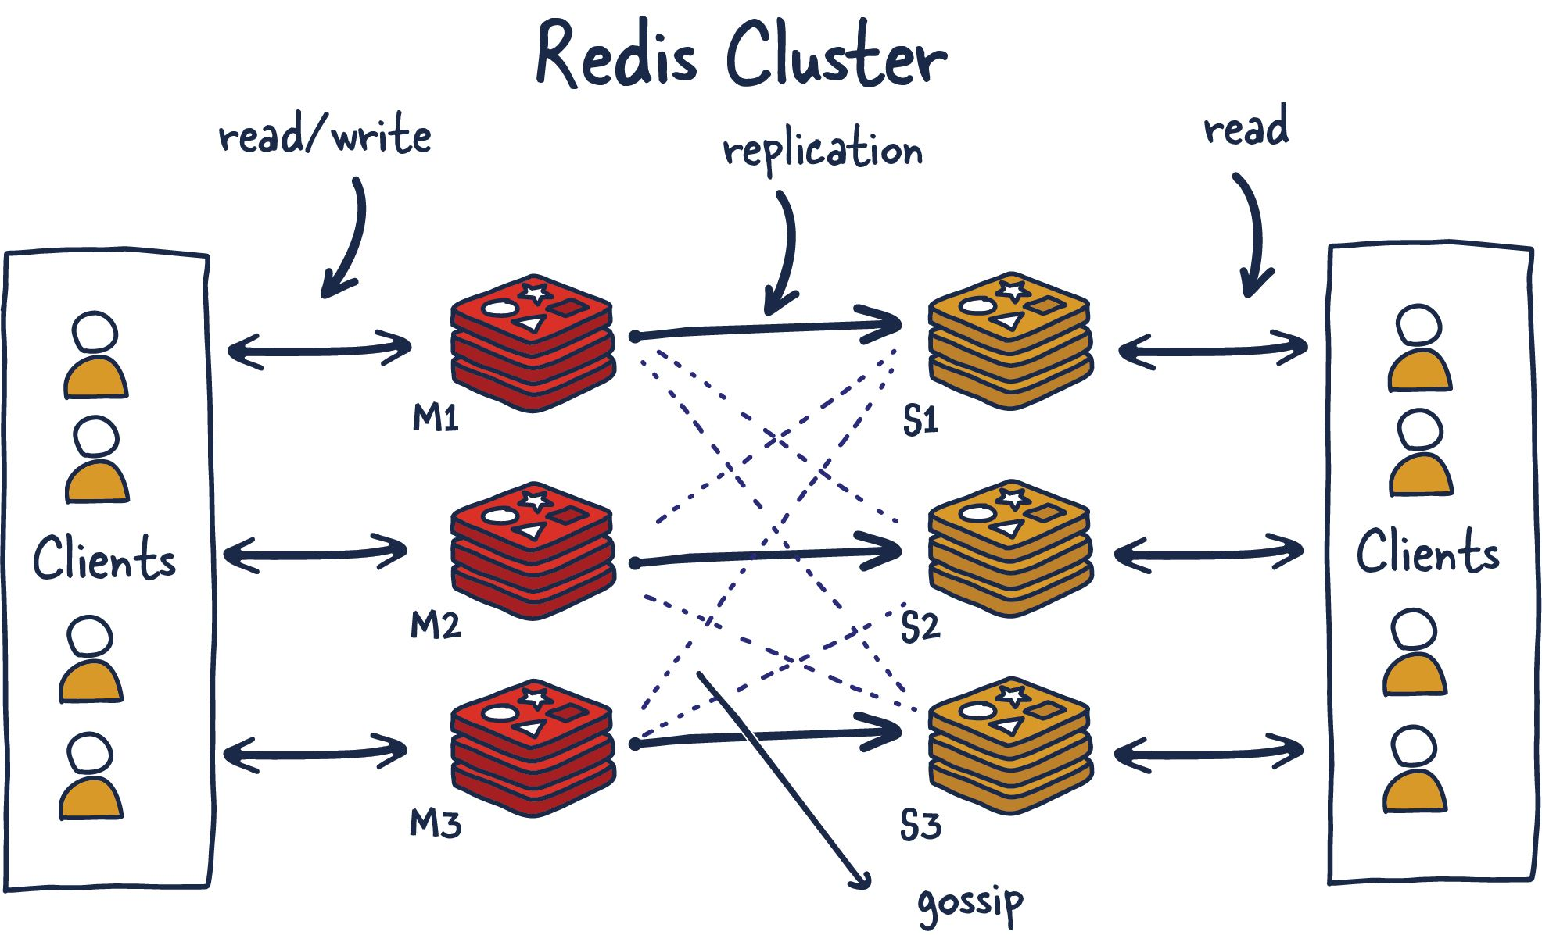

Slide 18
https://github.com/twitter/twemcache
Twemproxy, a lightweight proxy for Memcache & Redis protocol, enables the caching layer to scale horizontally minimizing the connections to the backend caching servers.
Twitter internally runs many caching services & one of them is powered by Redis. Redis clusters cache direct user messages, ad spends, impressions & engagement.
There is another caching service, Haplo which acts as a primary cache for the Twitter Timeline. It’s backed by Redis.
How Twitter Uses Redis To Scale - 105TB RAM, 39MM QPS, 10,000+ Instances

Slide 19
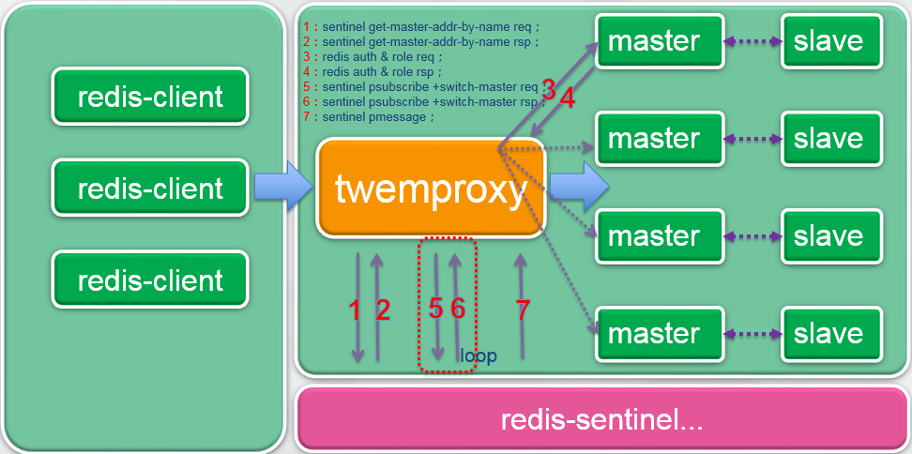
Notes:
Twemproxy är ett projekt skapat hos twitter
Man satte upp en grupp av master/slave sentinel noder och byggde en proxy framför som skötter sharding resolving och data upphämtning
Fördelarna för klienterna är att dom har 1 punkt att prata med, samma protokoll, twemproxy gör att klustret ser ut som 1 server oavsett hur många det är bakom
En annan stor fördel med produkten va att minska på antalet öppna anslutningar från clients → cluster noderna som tidigare va ett problem

Slide 20
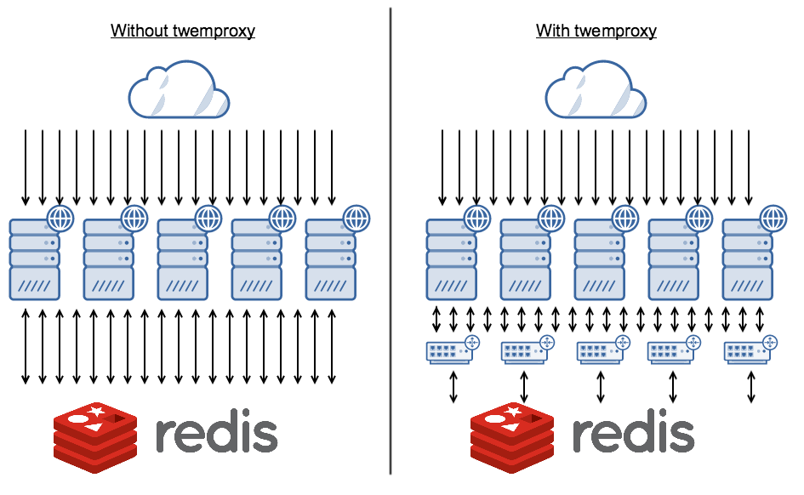

Slide 21
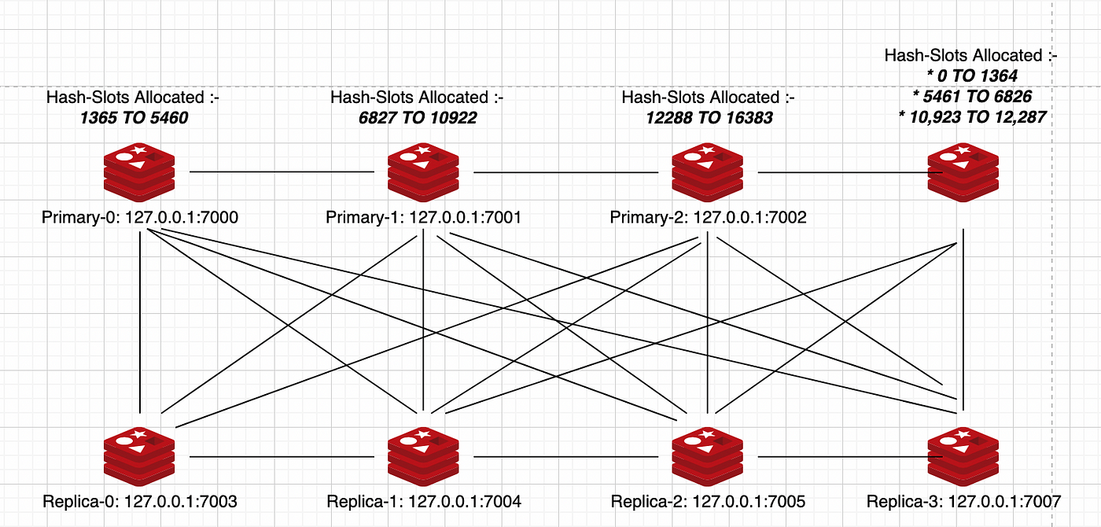

Slide 22
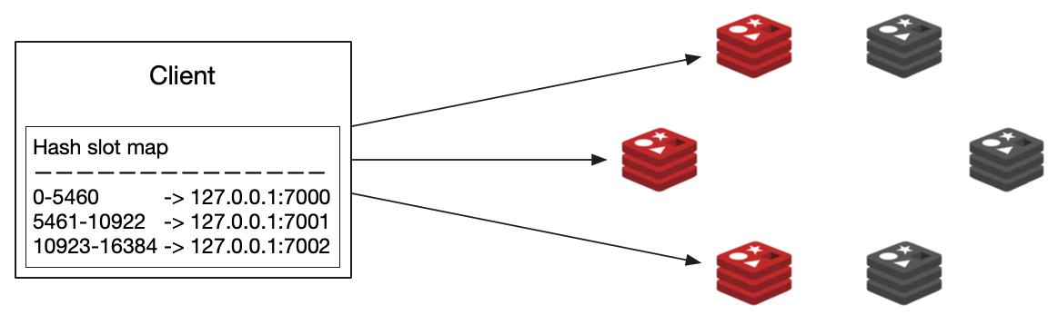
Cluster discovery

Slide 23
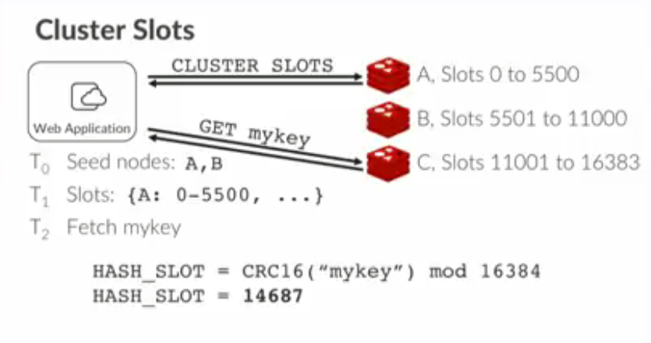

Slide 24
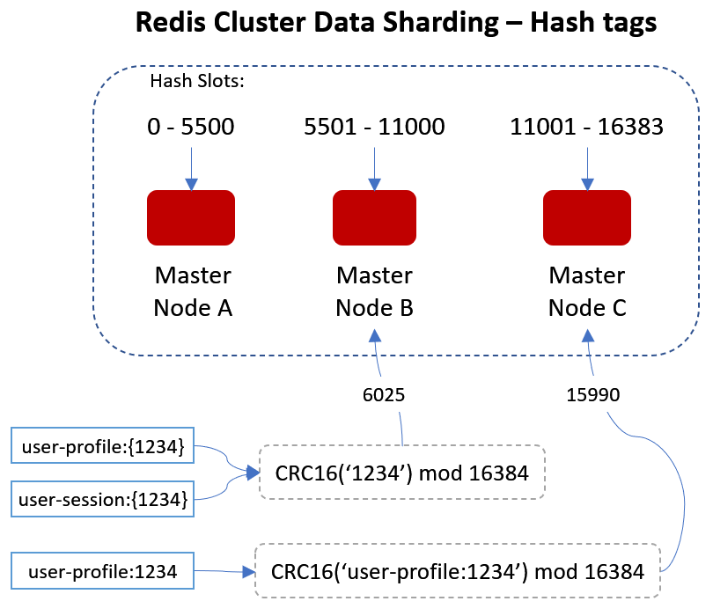

Slide 25
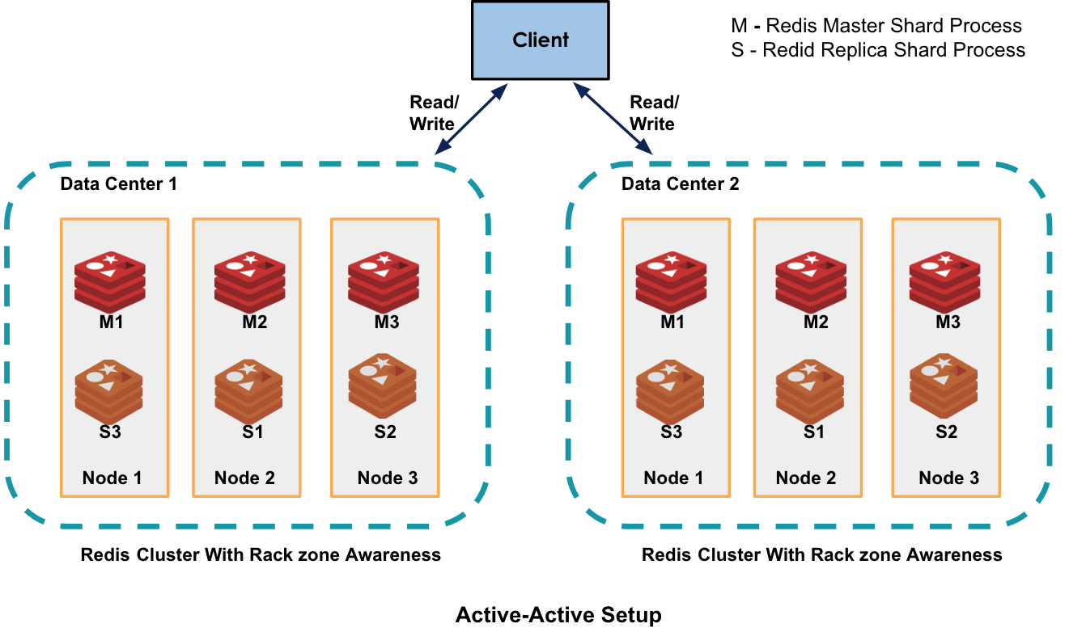

Slide 26
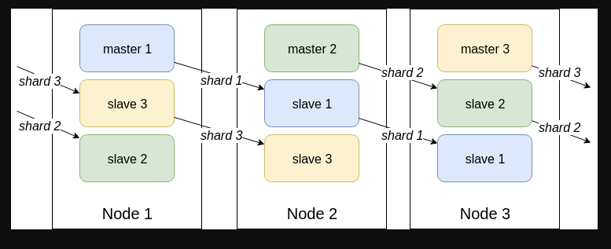

AZ-1
AZ-2
AZ-3

Slide 27
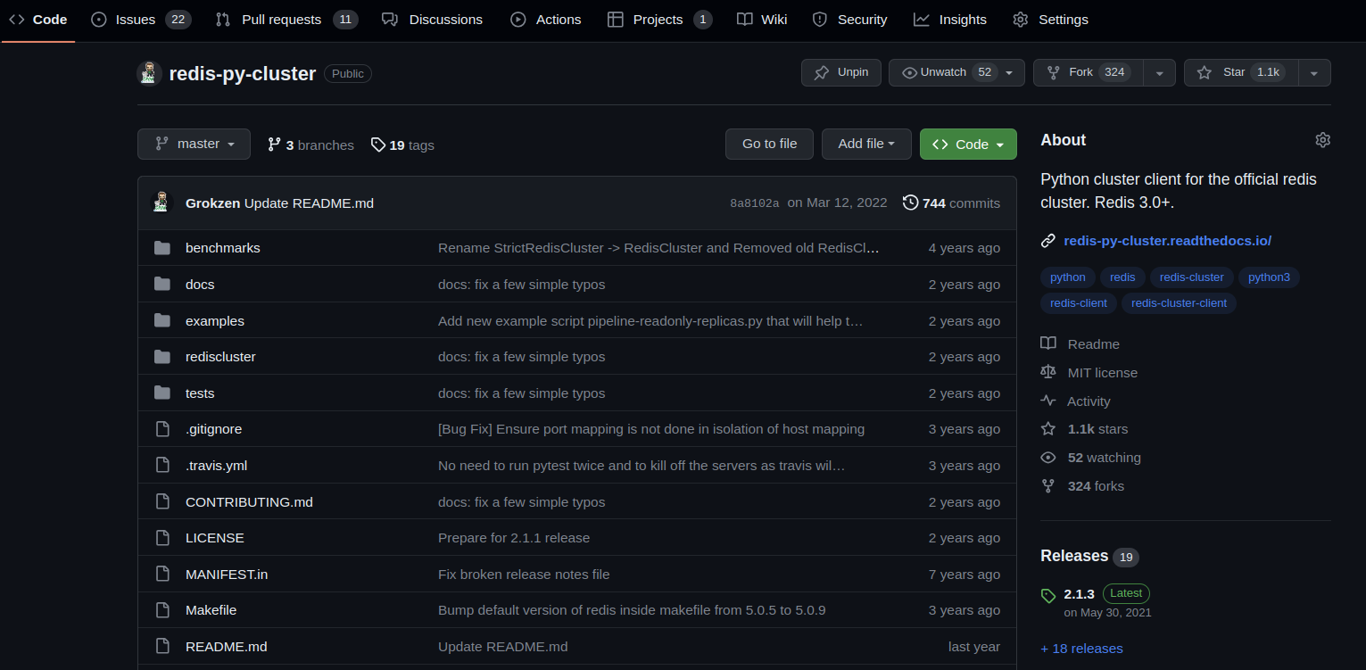

Slide 28
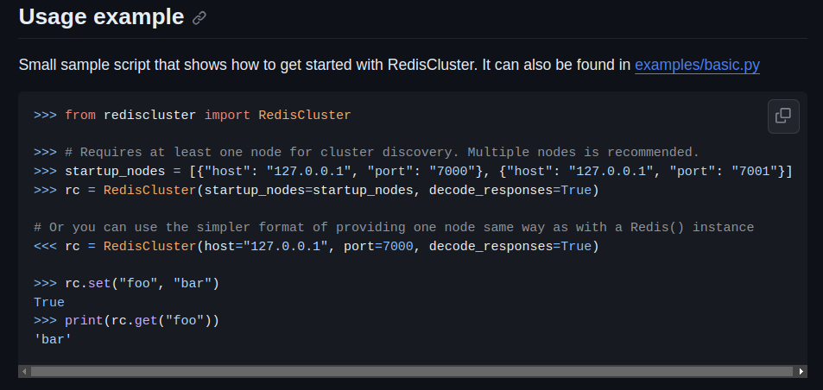

Slide 29
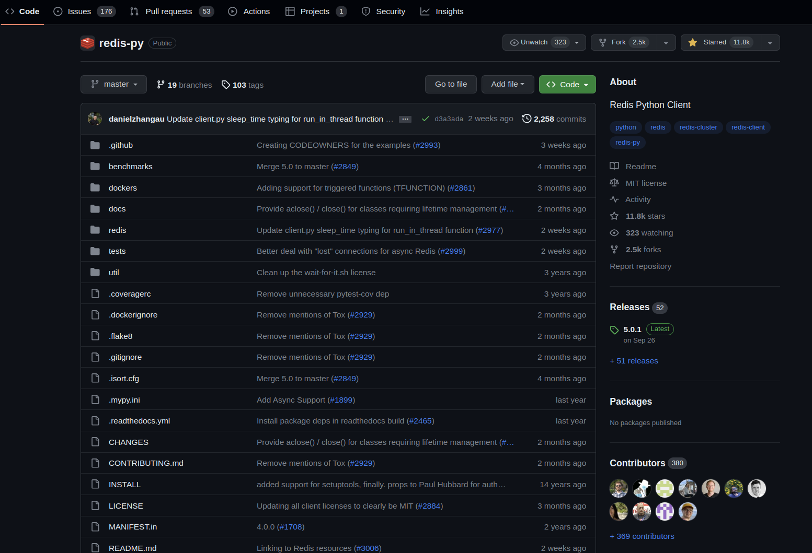

Slide 30

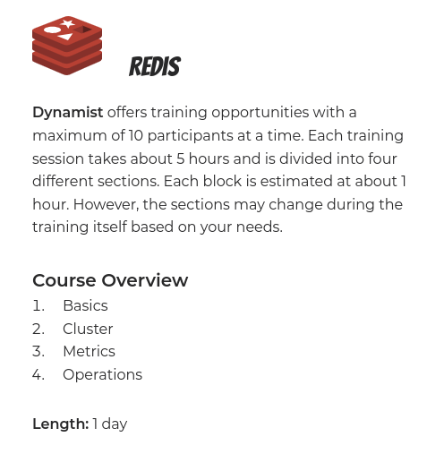

Slide 31
https://redis.readthedocs.io/en/stable/clustering.html
https://redis.io/
https://aws.amazon.com/redis/
https://twitter.com/antirez
https://github.com/redis/redis-py
https://github.com/Grokzen/redis-py-cluster
https://github.com/Grokzen/docker-redis-cluster
https://redis.com/redis-enterprise/technology/redis-enterprise-cluster-architecture/

